Slide 1
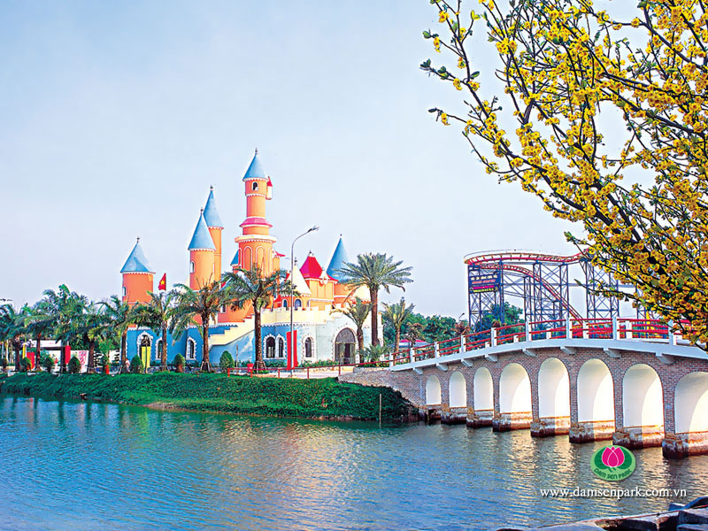
Welcome
TO OUR CLASS

Slide 2

UNIT 2: Clothing
Lesson 5:
LANGUAGE FOCUS
(P. 19-21)

Slide 3
Unit 2:
Clothing
Lesson 5: Language Focus (P19-21)
Content
I. Present Perfect
II. The Passive
III. Exercise for Present Perfect + Passive Voice

Slide 4
I. The Present Perfect Tense
1. Signs
for
already
since
(not) yet
Adverbs used with
the present perfect
recently
so far
lately
once/ twice/…
ever
2. Form:
+ Affirmative
S + have/has + V³/V-ed + O
Eg:
1/ I have seen this film already
2/ She has learned English for 3 years.

Slide 5
I. The Present Perfect Tense
1. Signs
since
already
recently
ever
so far
for
(not) yet
…….
lately
once/ twice
2. Form:
(+) Affirmative
S + have/has + V³/V-ed + O.
(-) Negative
S + have/has NOT + V³/V-ed + O.
(?) Interrogative
Have/Has + S + V³/V-ed + O?
→ Yes, S have/has
→ No, S haven’t/hasn’t
Eg:
She has learned English for 3 years.
(-) →
She has NOT (hasn’t) learned English for 3 years.
(?) →
Has she learned English for 3 years?

Slide 6
I. The Present Perfect Tense
1. Signs
since
already
recently
ever
for
(not) yet
lately
……
2. Form:
(+) Affirmative
S + have/has + V³/V-ed + O.
(-) Negative
S + have/has NOT + V³/V-ed + O.
(?) Interrogative
Have/Has + S + V³/V-ed + O?
3. Usage
Past Simple
action/event
happened
action/event
ended
with
definite time
Present Perfect
= don’t know
the time
Present Perfect
=NOT ended

Slide 7
I. The Present Perfect Tense
ACTIVITY 1: Make the similar dialogue
Exercise 1 (p.19)
Lan
old friend
six years
2019
a) Lan – (Hoa’s)old friend – six years - 2019
Nga
Nam
1.Work with a partner .Read the dialogue:
Nga: Come and see my photo album.
Nam: Lovely! Who’s this girl?
Nga: Ah! It’s _____, my ________.
Nam: How long have you made friend with her?
Nga: I’ve made friend with her for _________.
Nam: Have you seen her recently?
Nga: No, I haven’t seen her since _____.

Slide 8
I. The Present Perfect Tense
Exercise 1 (p.19)
b) Quang – brother’s friend / seven months /July
c) Hoa – new friend / three weeks / Monday
Nga
Nam
1.Work with a partner .Read the dialogue:
Nga: Come and see my photo album.
Nam: Lovely! Who’s this ?
Nga: Ah! It’s , my .
Nam: How long have you made friend with ?
Nga: I’ve made friend with for .
Nam: Have you seen recently?
Nga: No, I haven’t seen since .

Slide 9
I. The Present Perfect Tense
Exercise 1 (p.19)
b)
Quang
-
/
brother’s friend
seven months
July
/
Nga
Nam
1.Work with a partner .Read the dialogue:
Nga: Come and see my photo album.
Nam: Lovely! Who’s this ?
Nga: Ah! It’s , my .
Nam: How long have you made friend with him ?
Nga: I’ve made friend with him for .
Nam: Have you seen him recently?
Nga: No, I haven’t seen him since .
boy

Slide 10
I. The Present Perfect Tense
Exercise 1 (p.19)
c)
Hoa
-
/
new friend
three weeks
Monday
/
Nga
Nam
1.Work with a partner .Read the dialogue:
Nga: Come and see my photo album.
Nam: Lovely! Who’s this _ ?
Nga: Ah! It’s , my .
Nam: How long have you made friend with her ?
Nga: I’ve made friend with her for .
Nam: Have you seen her recently?
Nga: No, I haven’t seen her since .
girl

Slide 11
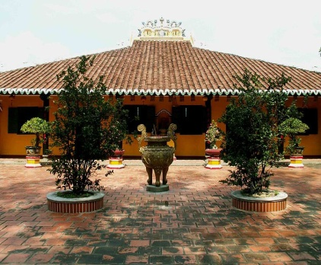

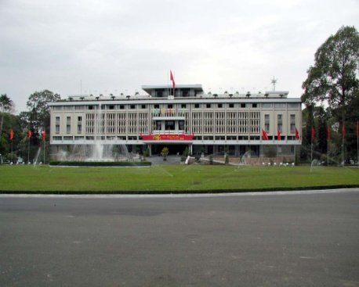

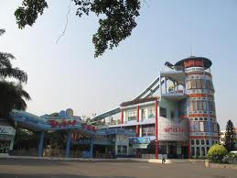
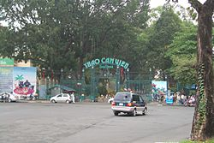
I. The Present Perfect Tense
ACTIVITY 2: Ask and Answer questions about the things you have done. (Use the verb in the box) Exercise 2 (p.20)
SIGHTS
try visit see go eat
Giac Lam Pagoda .
Have you seen Giac Lam Pagoda ?
Reunification Palace
Yes ,I’ve already seen it
Dam Sen
Amusement Park
Have you visited Reunification Palace?
No,I haven’t
Zoo and Botanical
Gardens

Slide 12
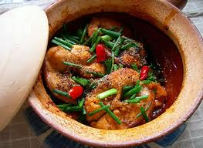
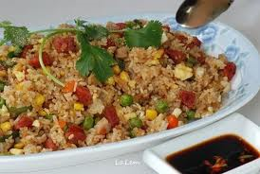
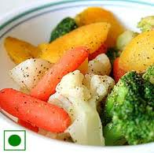

I. The Present Perfect Tense
ACTIVITY 2: Ask and Answer questions about the things you have done. (Use the verb in the box) Exercise 2 (p.20)
FOOD
try visit see go eat
Vietnamese food
Have you tried/ eaten Vietnamese food?
Chinese food
No , I haven’t
vegetarian
Have you tried/ eaten Chinese food?
Yes,I have.
French food

Slide 13
I. The Present Perfect Tense
ACTIVITY 3: Ask and Answer questions about your experiences. (Use the items in the box) Exercise 3 (p.20)
1. 2. computer 3. supermarket 4. volleyball
5. Singapore 6. movies 7. elephant 8.Hue 9.durian
comic
Eg:
Have you ever read a comic?
Yes , I have
When did you last read one?
This morning.
YOU
YOUR FRIEND

Slide 14

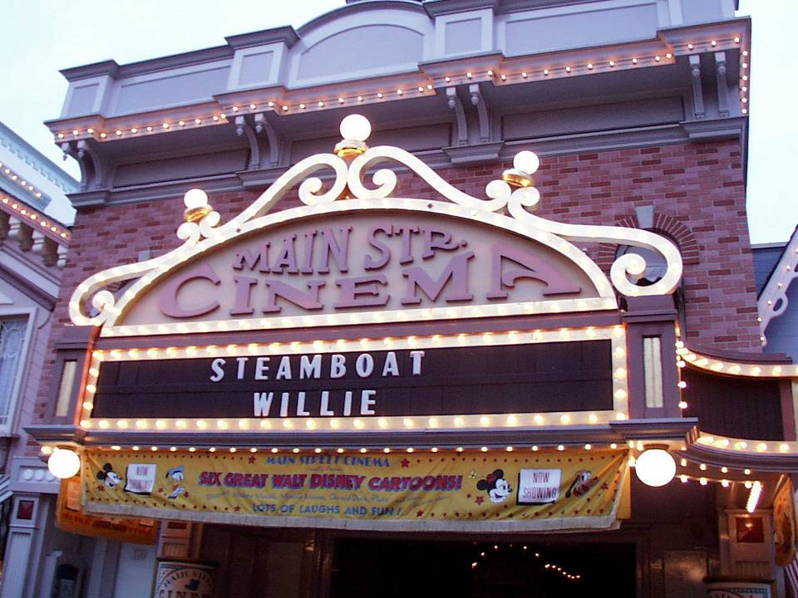
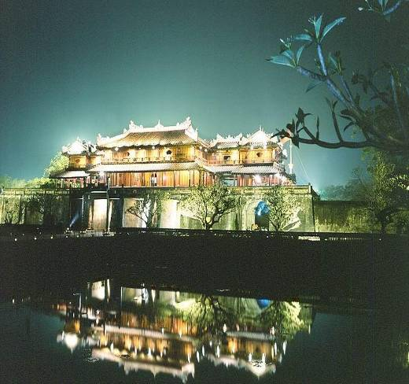
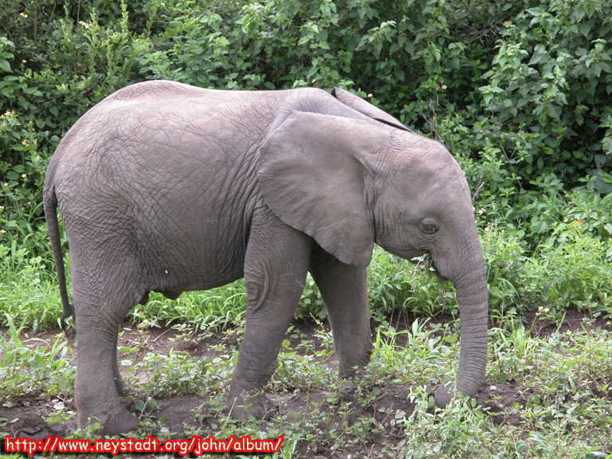

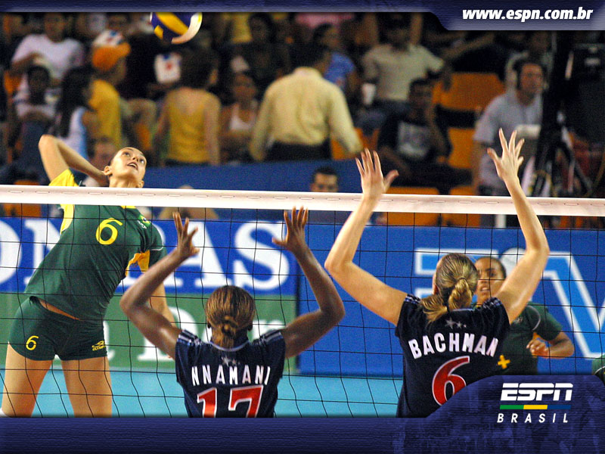
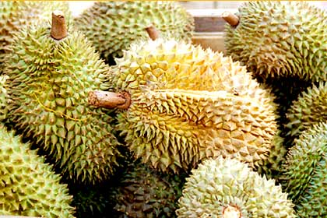
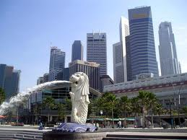
I. The Present Perfect Tense
ACTIVITY 3: Ask and Answer questions about your experiences. (Use the items in the box) Exercise 3 (p.20)
1. 2. computer 3. supermarket 4. volleyball
5. Singapore 6. movies 7. elephant 8.Hue 9.durian
Have you ever ……….?
Yes , I have
Hue
When did you last …………?
YOUR FRIEND
YOU
………….

Slide 15
II.The passive voice
ACTIVE VOICE
S V O M P T
S
BE
V^{ED/3}
M P
BY
O T
PASSIVE VOICE
How to change an ACTIVE VOICE → PASSIVE VOICE
1. Change O (in active sentence) → S (in passive sentence)
2. Add TO BE into Passive sentence
( NOTES: Tense of TO BE = Tense of V in active sentence)
3. Change V (in active sentence) → V^{ed/3 -} Past Participle (in passive sentence)
4. Add BY into Passive Sentence
5. Change S (in active sentence) → O (in passive sentence)

Slide 16
Notes: TO BE in Passive sentences
1/ Present simple tense.
Active : S + V_{-Bare}/V_{-s/-es} + O
Passive: S + + V³/^{ed} + by O
is / are / am
2/ Past simple tense.
Active : S + V-ed/-2 + O
Passive: S + + V³/^{ed} + by O
was / were
3/ Present perfect tense
Active : S + have/has + V-^{ed/3} + O
Passive: S + + V³/^{ed} + by O
have/ has been
4/ Modal Verbs, Have to, Be going to:
Active : S + Modal V +V_{-bare} + O
Passive: S + + V³/^{ed} + by O
Modal V + BE
can/ could/will/ would… + BE
have/ has to // am/is/are going to BE

Slide 17
Notes: TO BE in Passive sentences
TENSES | FORM OF VERB | => | TO BE
Present Simple | V_{-Bare}/V^{-S/ES} | => | am/ is/ are
Past Simple | V^{-ED/2} | => | was/ were
Future Simple | WILL/ SHALL +V_{-Bare} | => | will be
Past Continuous | WAS/ WERE +V^{-ING} | => | was/ were being
Present Continuous | AM/ IS/ ARE +V^{-ING} | => | am/ is/ are being
Future Continuous | WILL BE + V^{-ING} | => | will be being
Past Perfect | HAD + V^{ED/3} | => | had been
Present Perfect | HAVE/ HAS + V^{ED/3} | => | have/ has been
Future Perfect | WILL HAVE + V^{ED/3} | => | will have been

Slide 18
II.The passive voice
ACTIVITY 4: Complete the second sentence with the same meaning with that of the first one. Use the passive form. Exercise 4 (p.21)
a. They made jean cloth completely from cotton in the 18th century.
→Jean cloth…..
b. They grow rice in tropical countries.
→ Rice…….
c. They will produce five million bottles of champagne in France next year.
→ Five million bottles of champagne…
d. They have just introduced a new style of jeans in the USA
→A new style of jeans……
e. They have built two departments store this year..
→ Two department stores …..
was made completely from cotton in the 18th century
is grown in tropical countries.
will be produced in France next year.
has just been introduced in the USA
have been built this year.

Slide 19
II.The passive voice
ACTIVITY 5:Change the sentences from the active into the passive. Exercise 5 (p.21)
Eg: You must do the exercise carefully
→ The exercise must be done carefully.
We can solve the problem.
b. People should stop experiments on animals.
c. We might find life on another planet.
d. We have to improve all the schools in the city.
e. They are going to build a new bridge in the area.
-
→ The problem can be solved by us.
→ Experiments on animals should be stopped.
→ Life might be found on another planet.
→All the schools in the city have to be improved.
→ A new bridge in the area is going to be built.

Slide 20

Homework :
- Do all exercises (1-2-3-4-5) on pages 19 – 21 again
- Prepare for Unit 3:
Getting started – Listen & read (p.22-23)

Slide 21

GOODBYE
See you again.

